Slide 1
PROJECT: IDEALS LAB "From Theory to Practice: Designing a User-Friendly Website for Educators and Researchers"
CSCE 606 - Software Engineering
Client: Jonan Phillip Donaldson
Team Members: Chonglin Zhang, Isuranga Perera, James Camp,
Ritika Nigam, Sidharth Anil, Yuntao Xie

Slide 2
Motivation
To improve the quality of education and help educators and researchers design more effective teaching and learning experiences.
To combat the cumbersome and visually unappealing concept map generated through the Miro board.

Slide 3
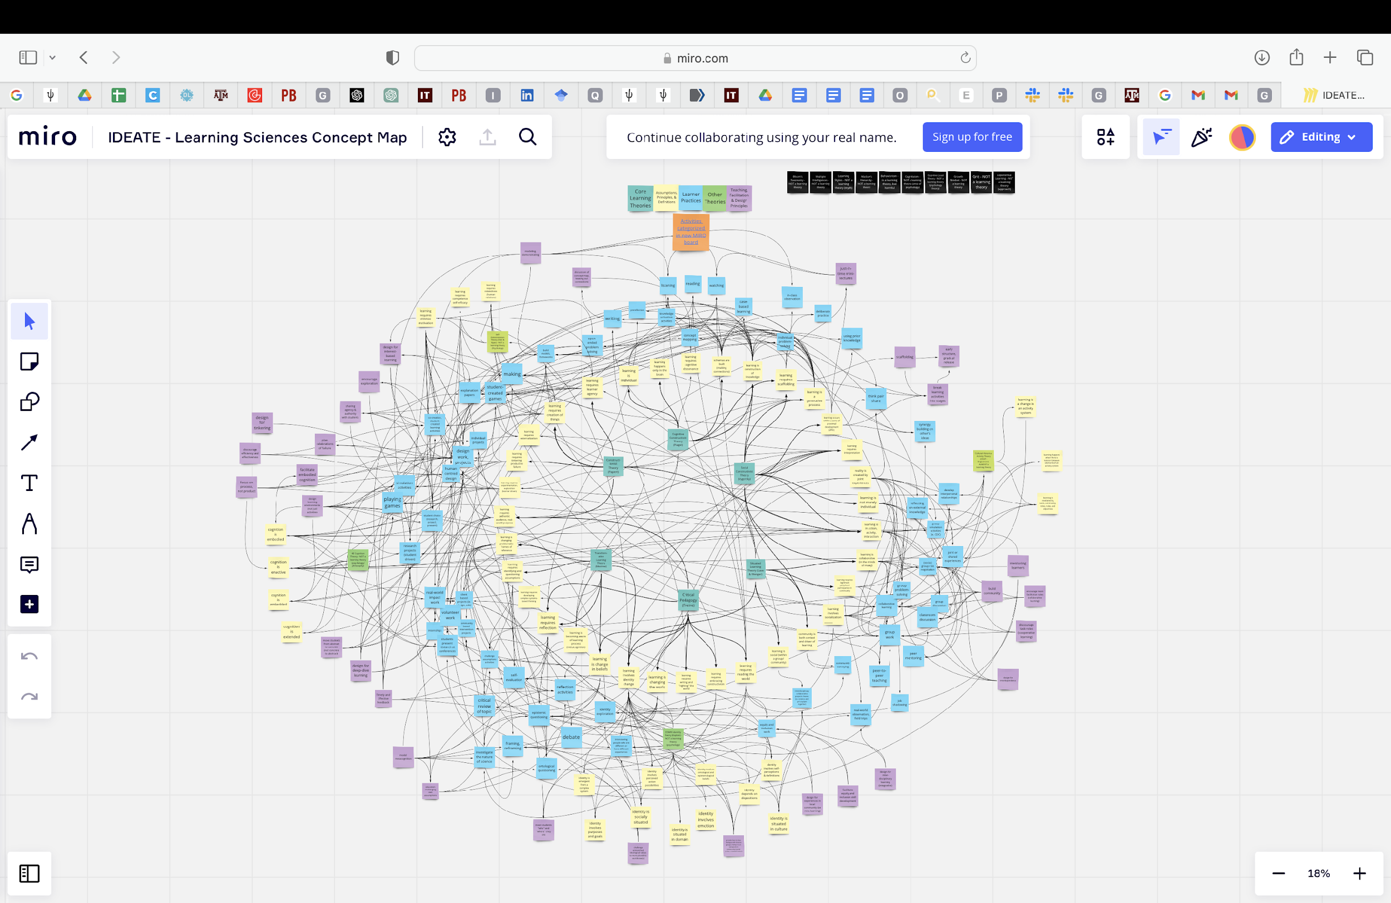
Concept Map- Miro Board

Slide 4
Goal
To build a highly interactive visual website that transforms the difficult-to-view concept map into a convenient, user-friendly platform.
To provide a simplified interface upfront, which does not overwhelm the users.
To allow users to traverse the map from any of the features - theories, assumptions, and practices.

Slide 5
Website Workflow and Key Features

Slide 6
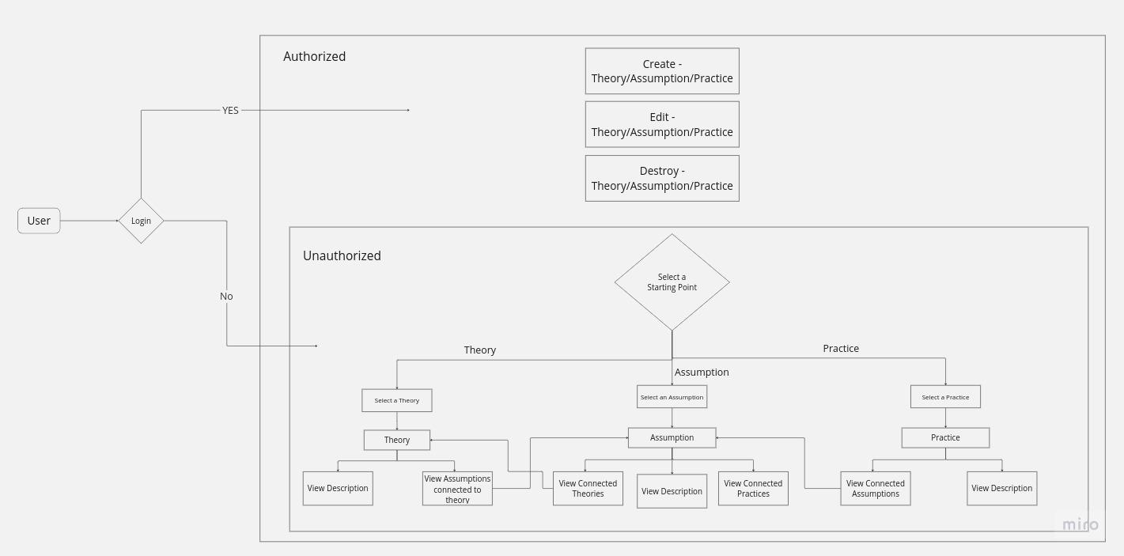
Workflow Design

Slide 7
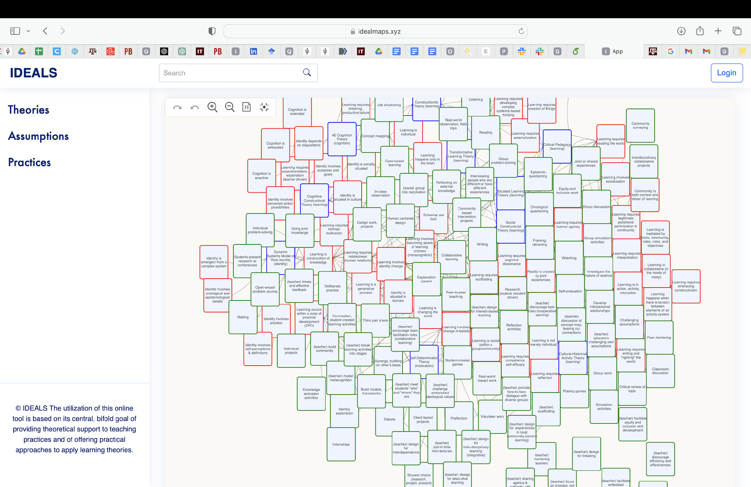
IDEALS-Website
Search Bar
User login
Left Panel
(Descriptive view)
Right Panel
(Visual map view)

Slide 8
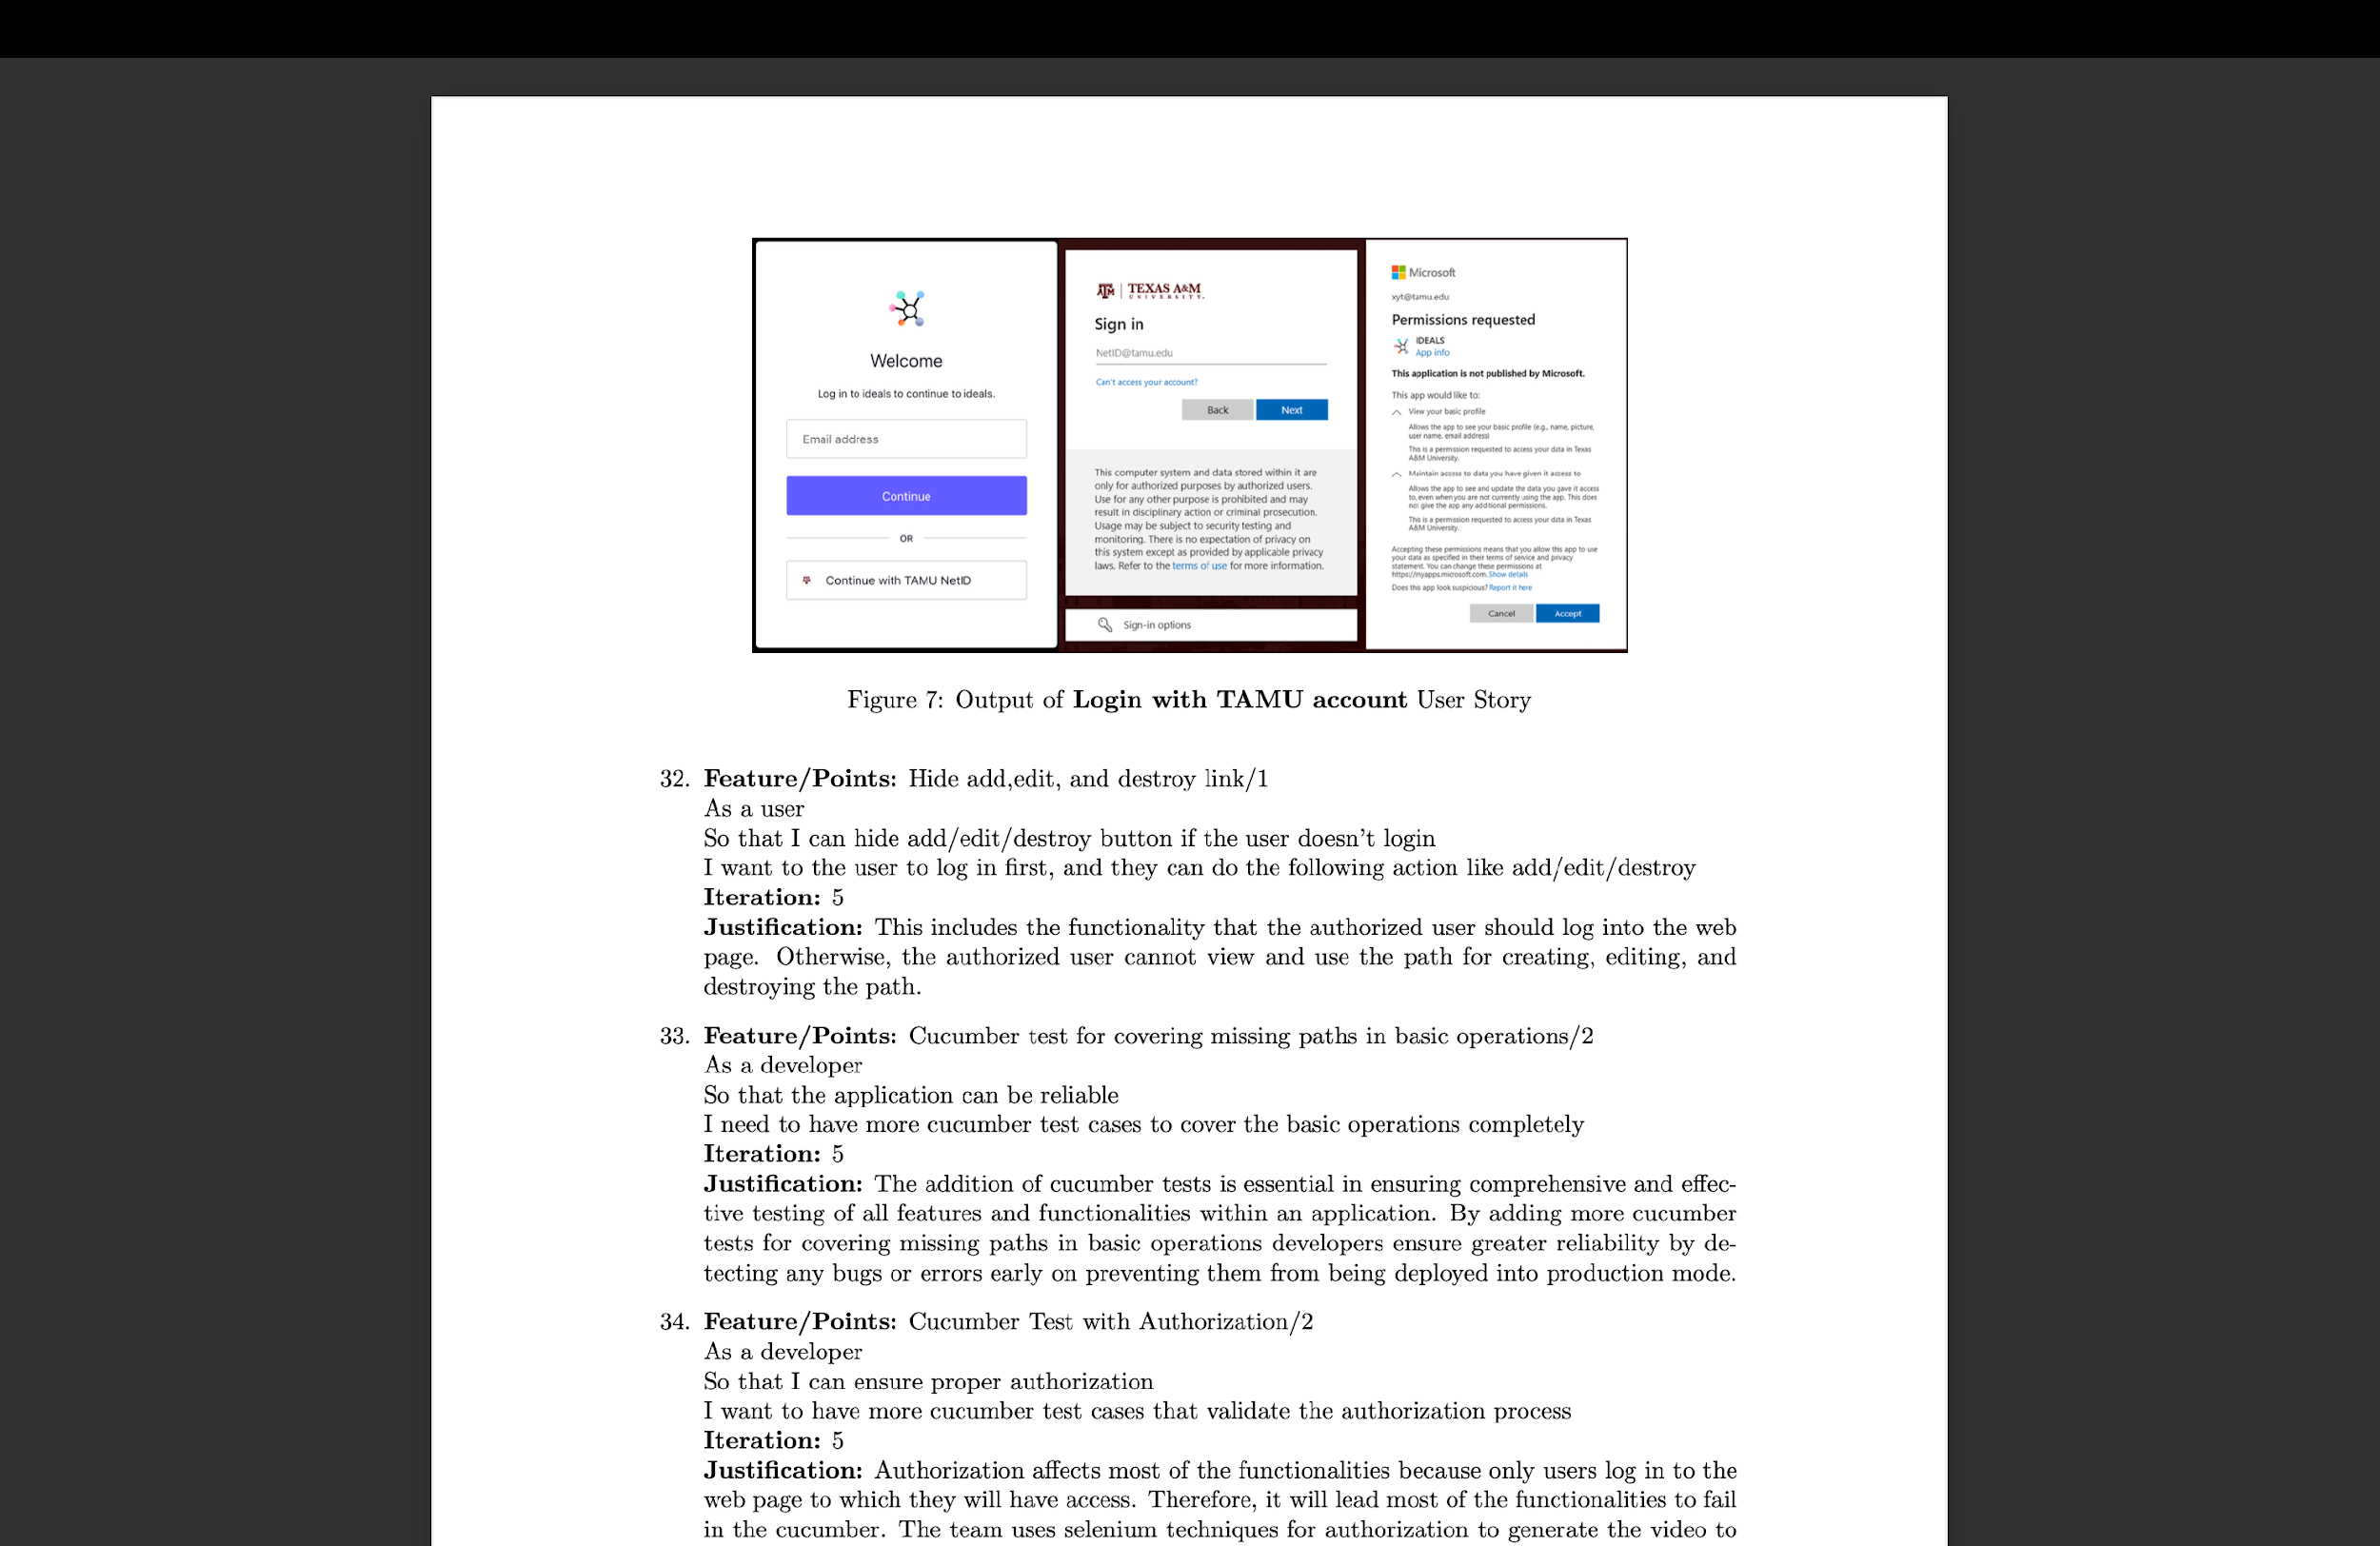
User Login

Slide 9
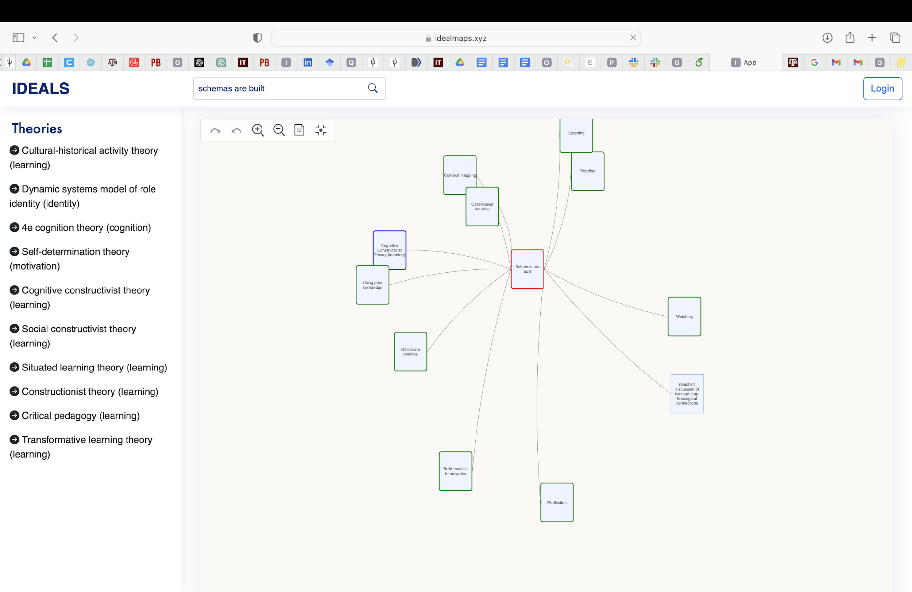
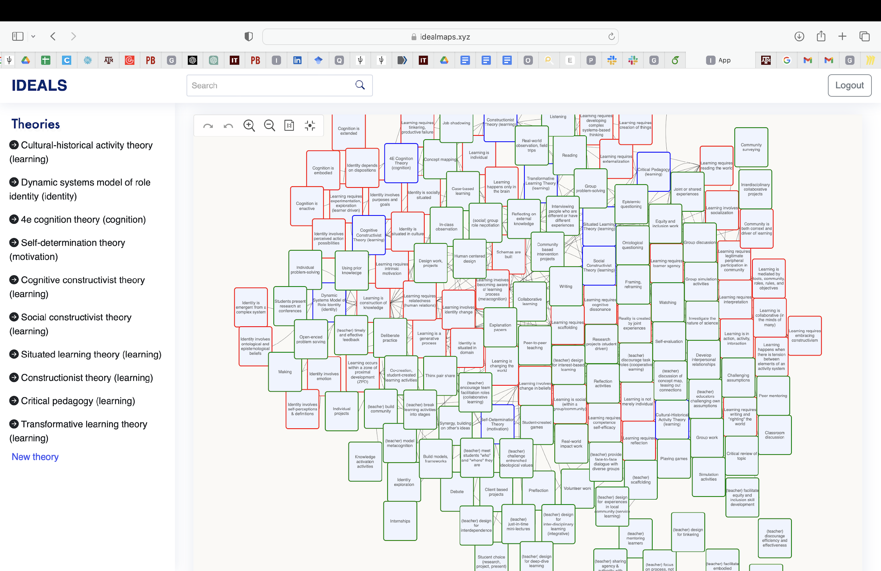
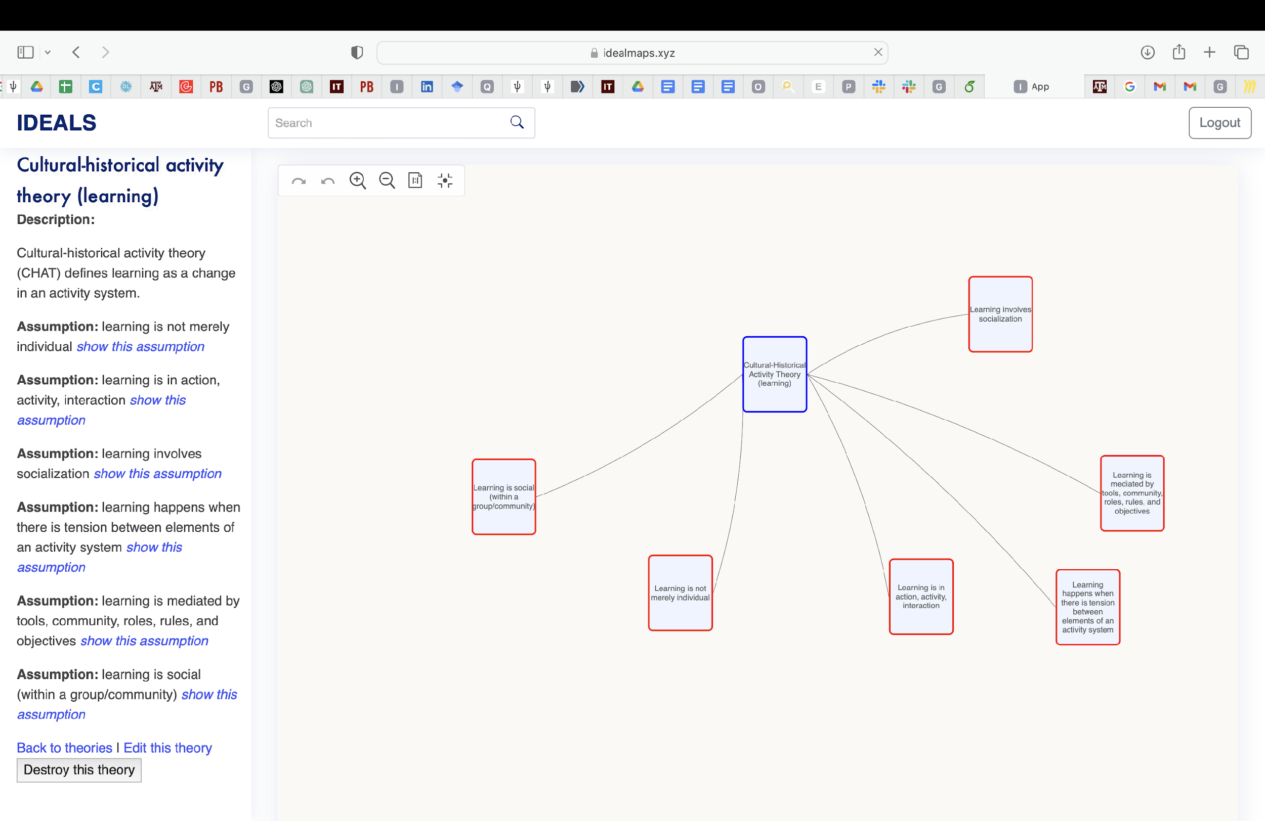
View mode and Edit mode
View mode
Edit mode
Can add new theories
Can delete any existing theory

Slide 10
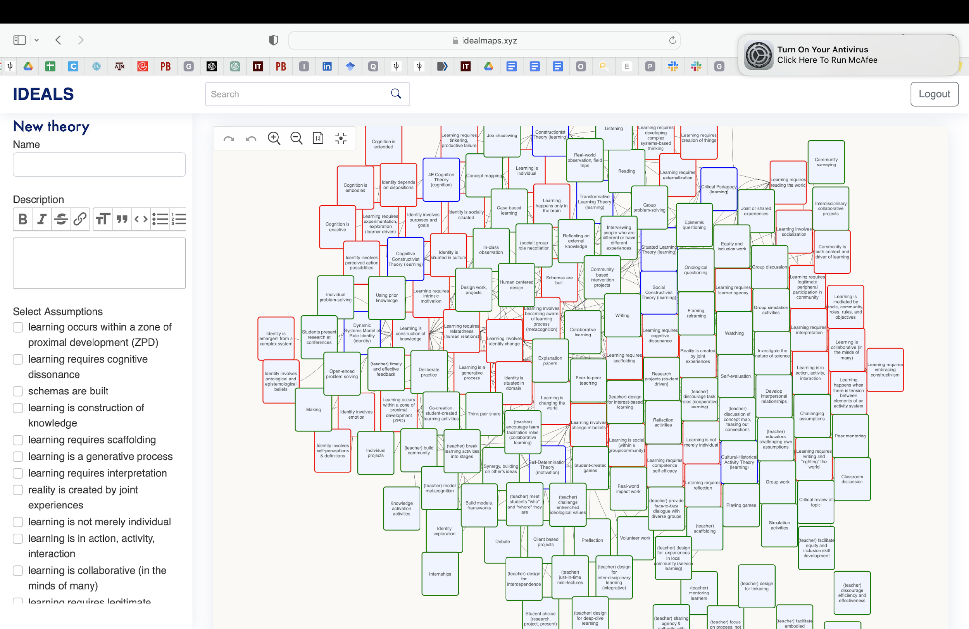
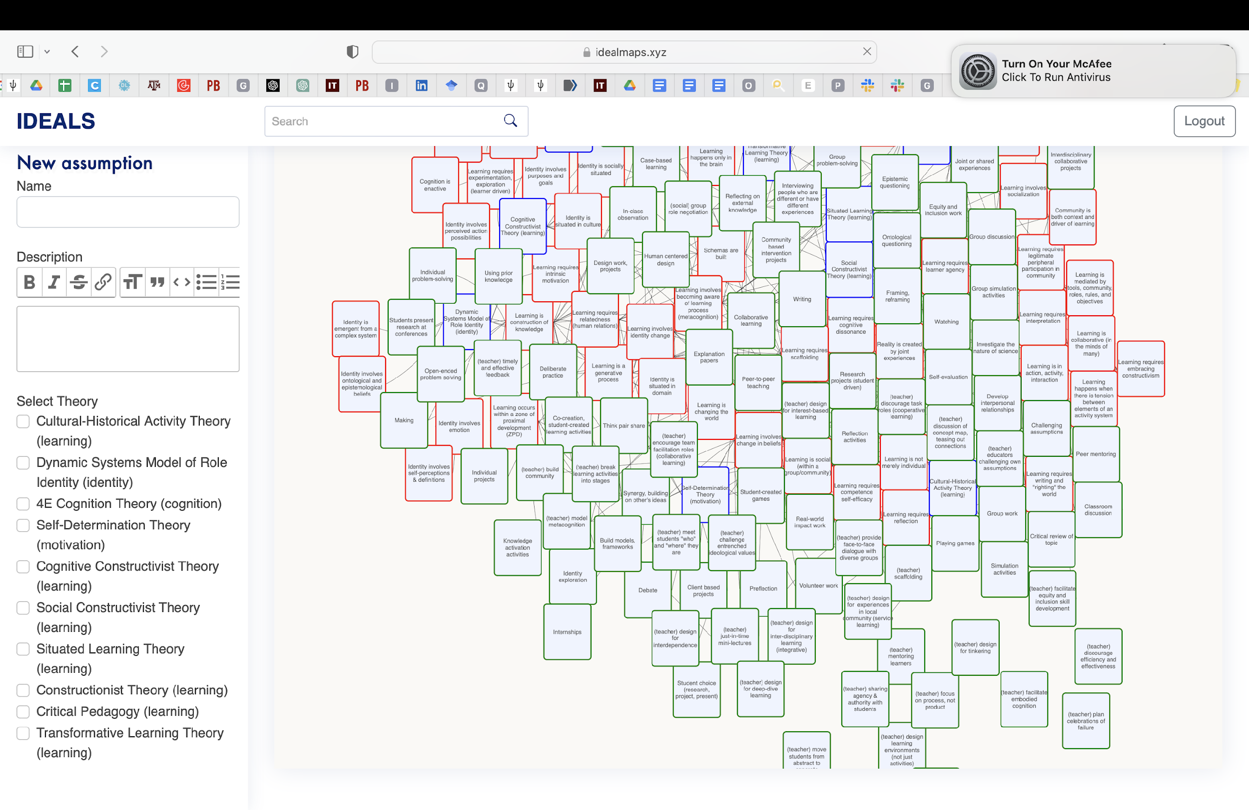
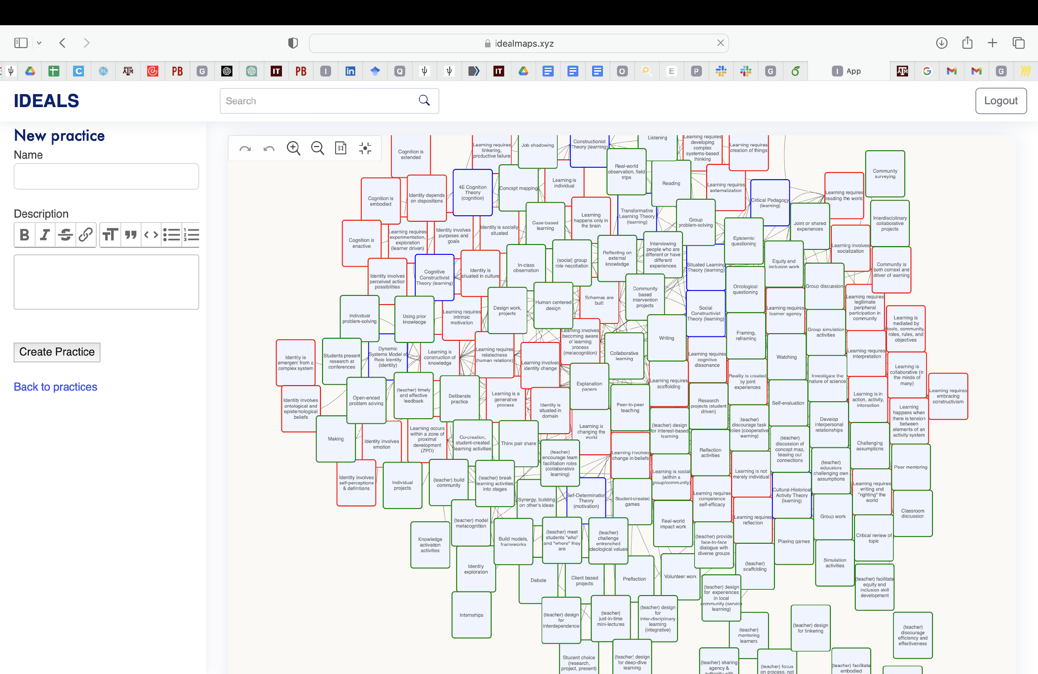
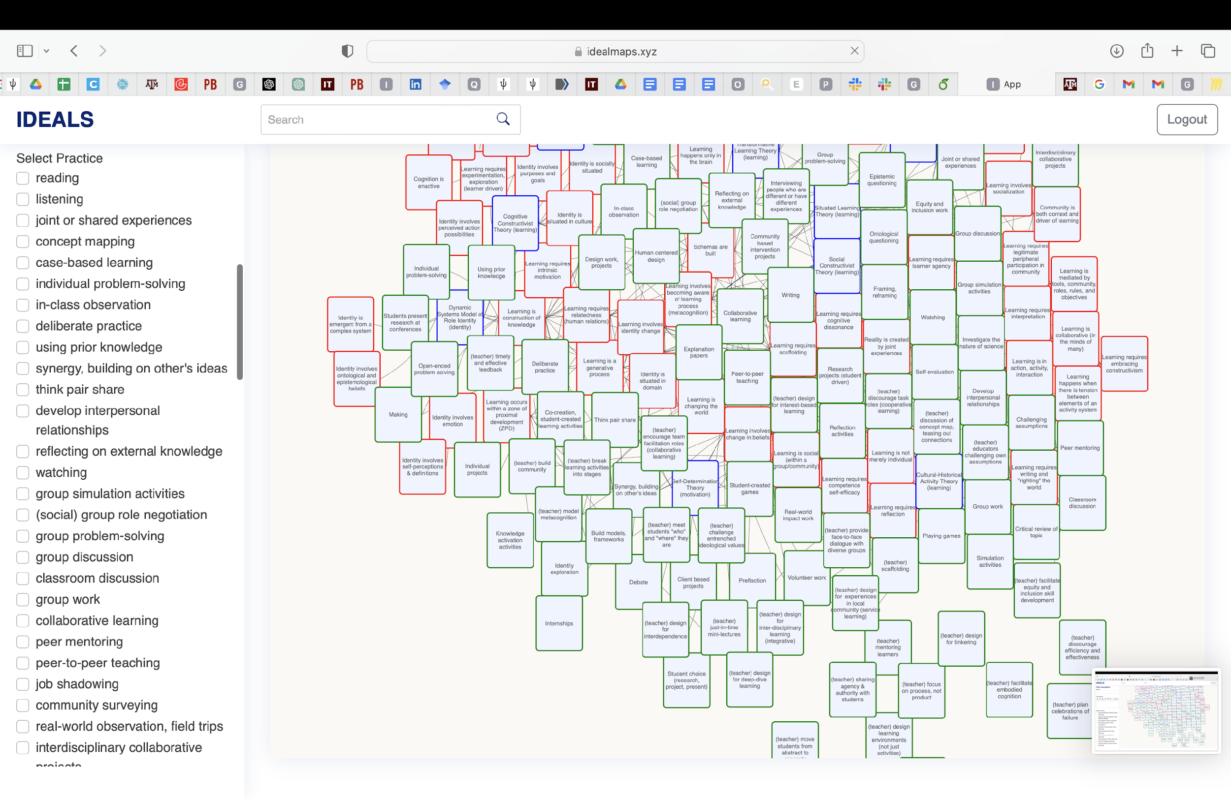
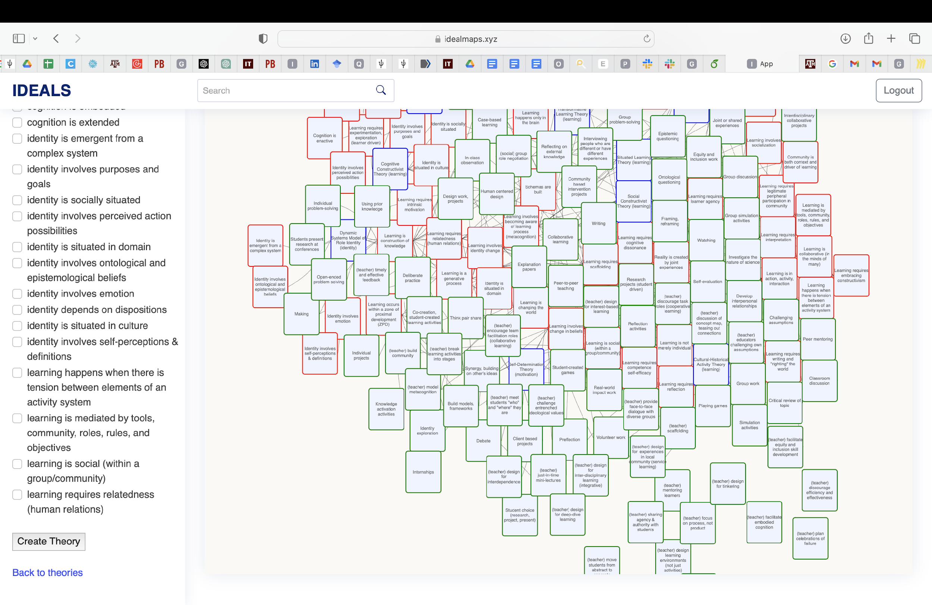
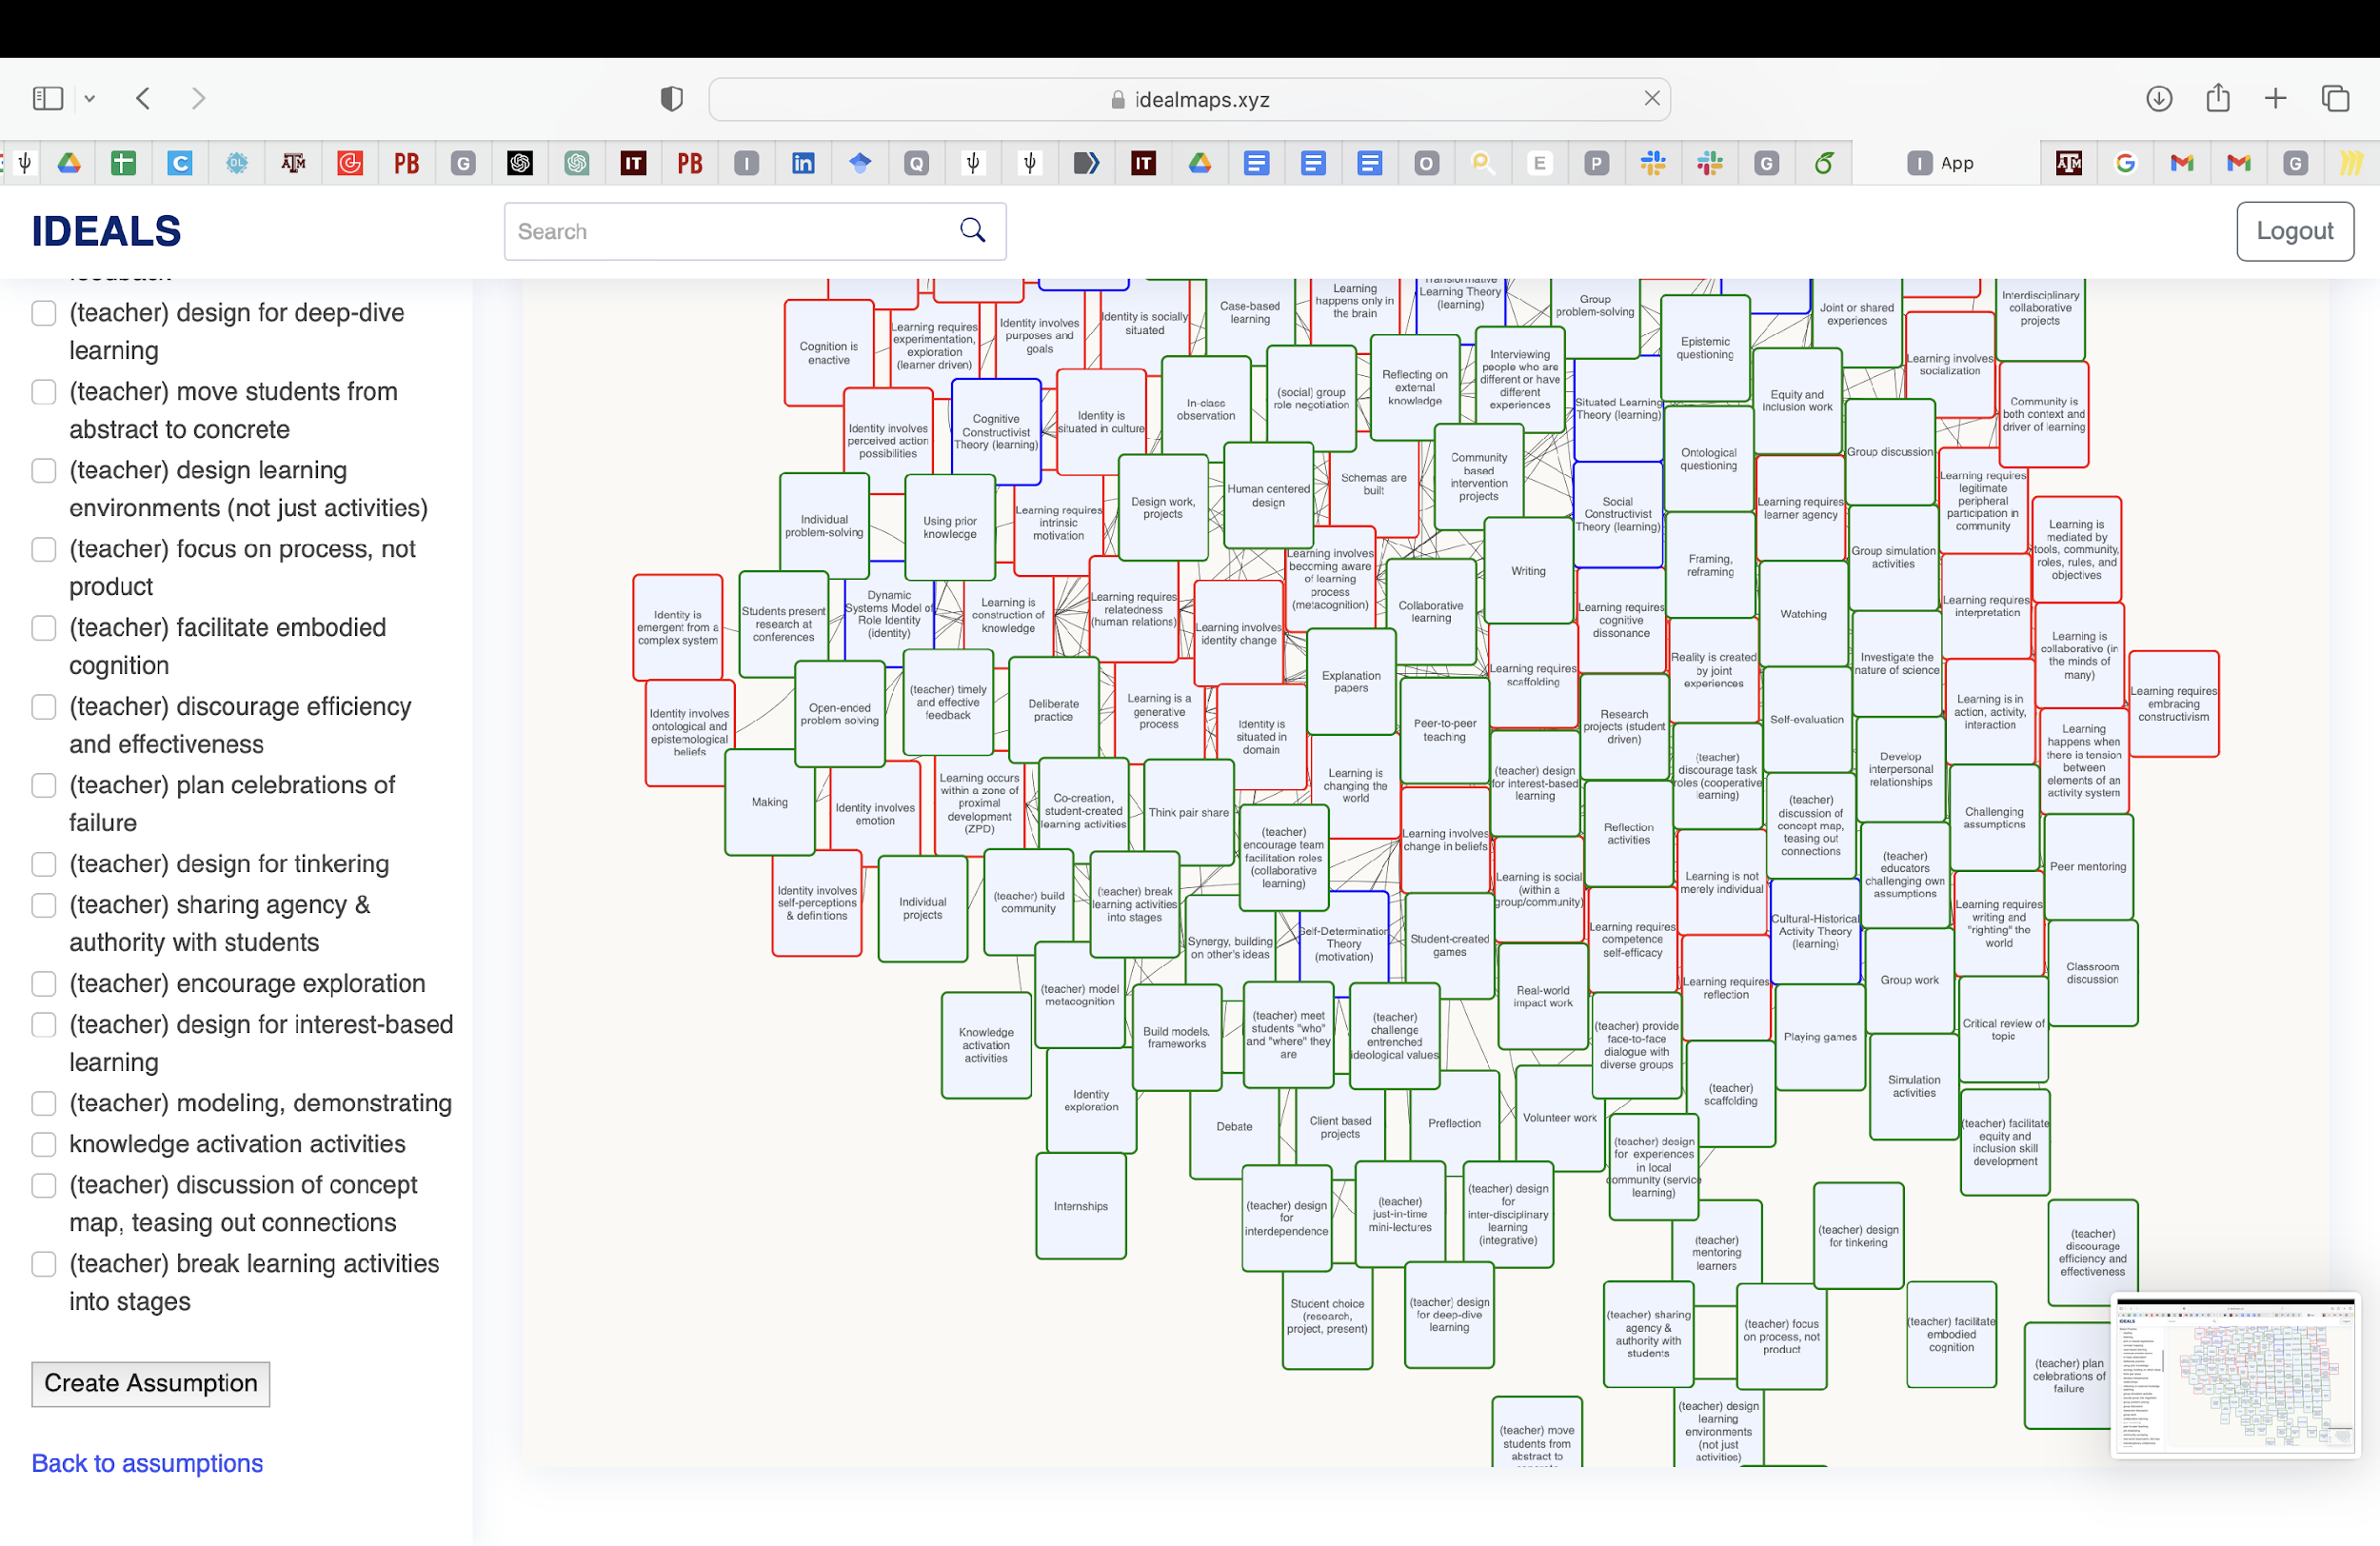
Create new Theo/Assump/Prac

Slide 11
Theories

Slide 12
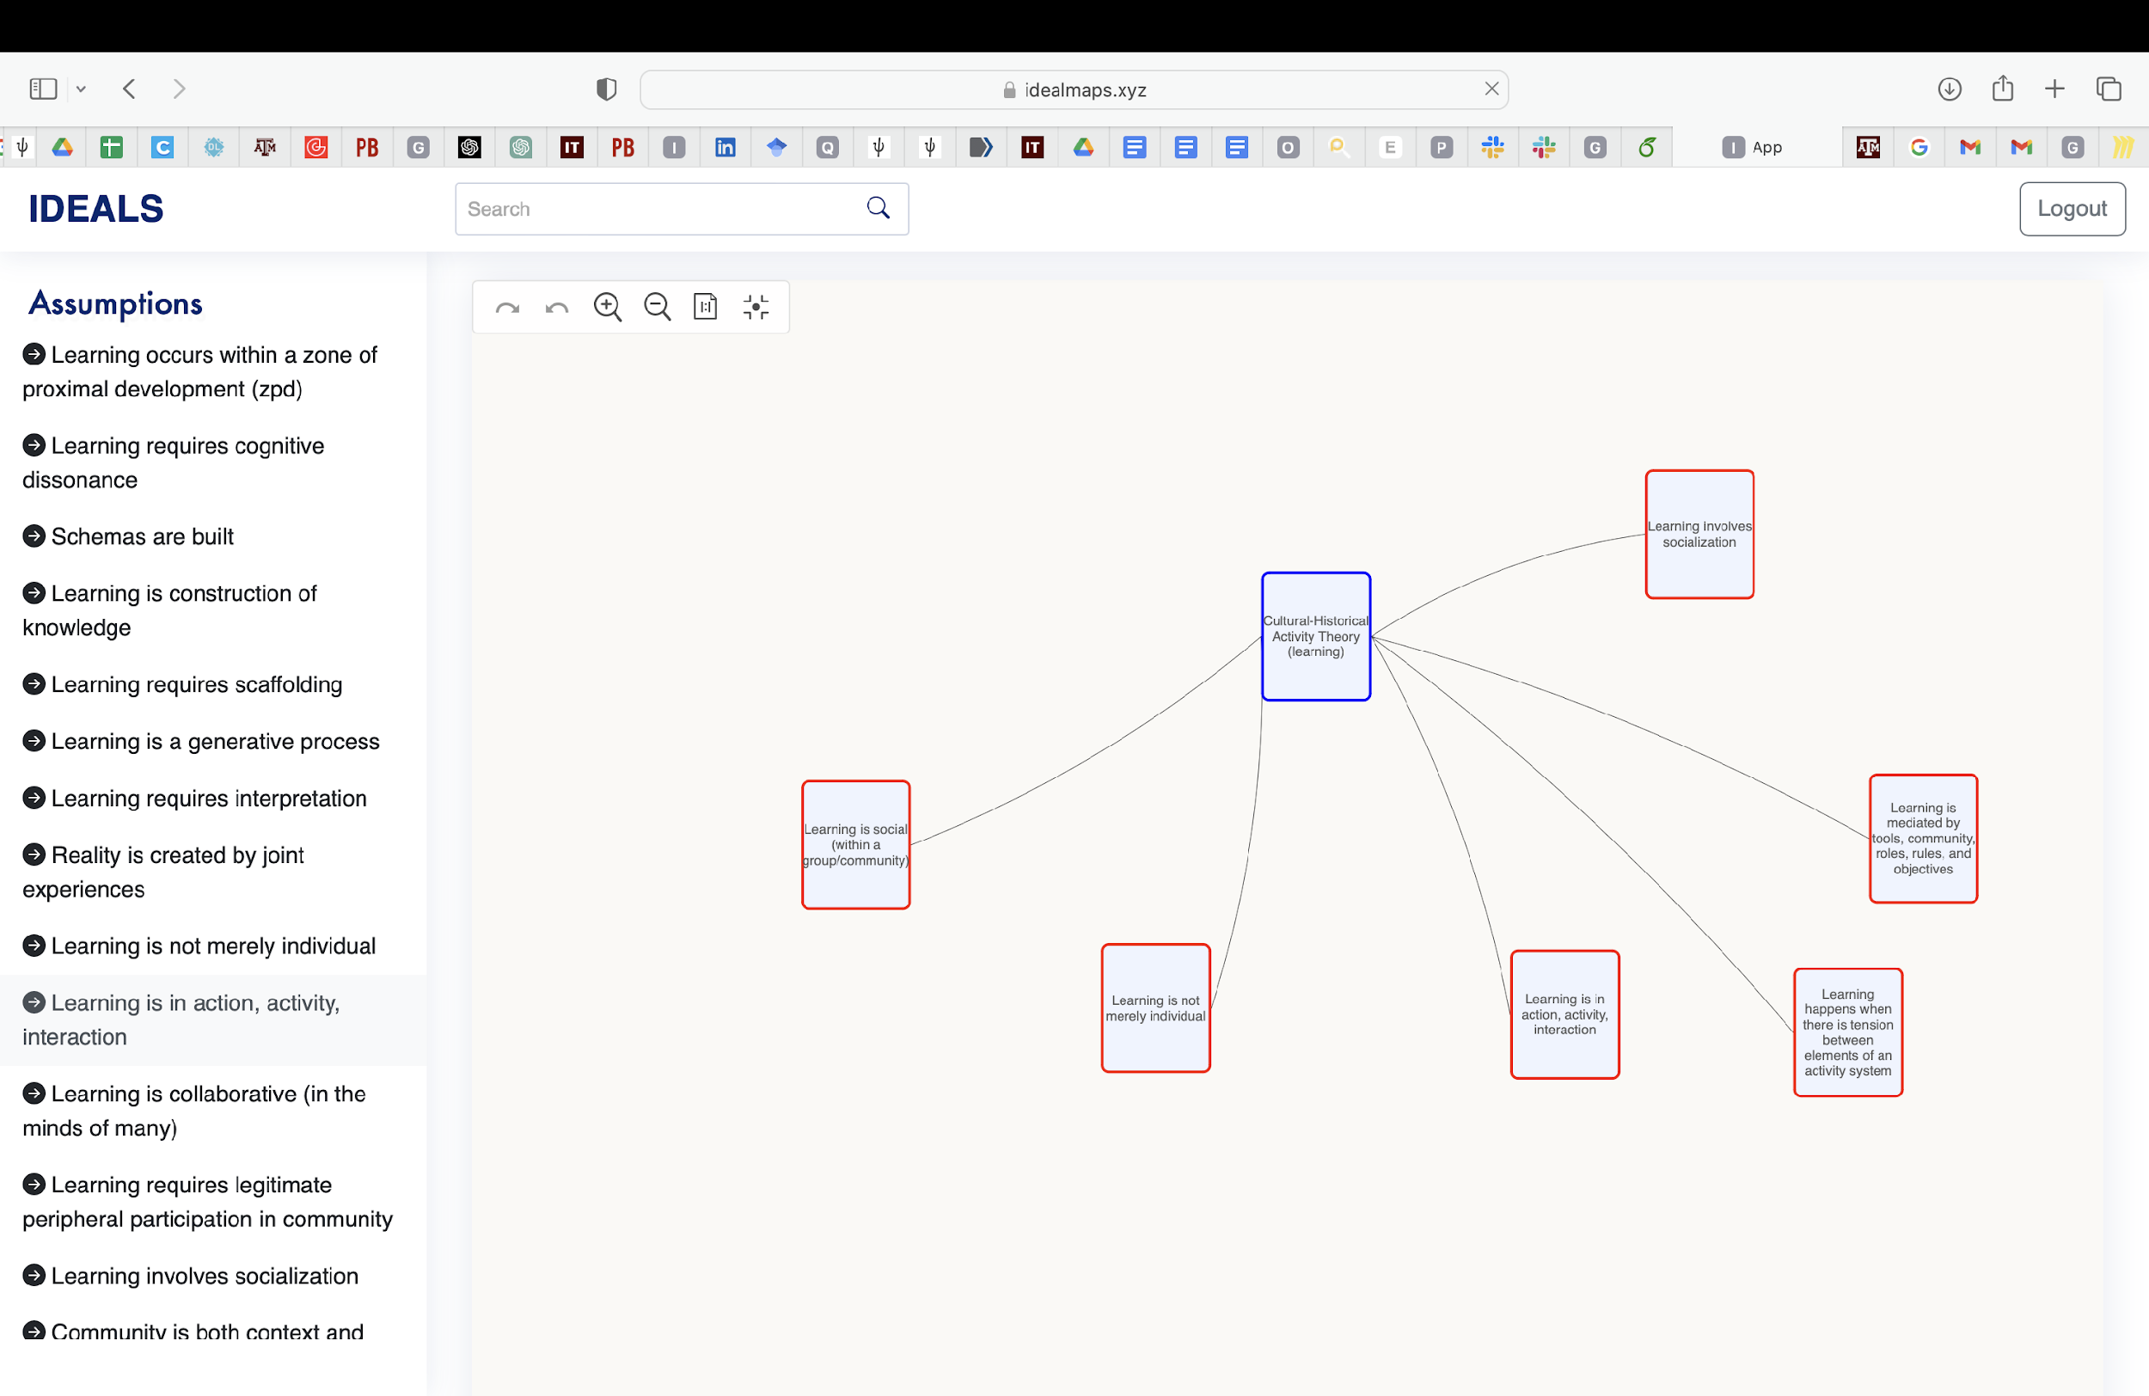
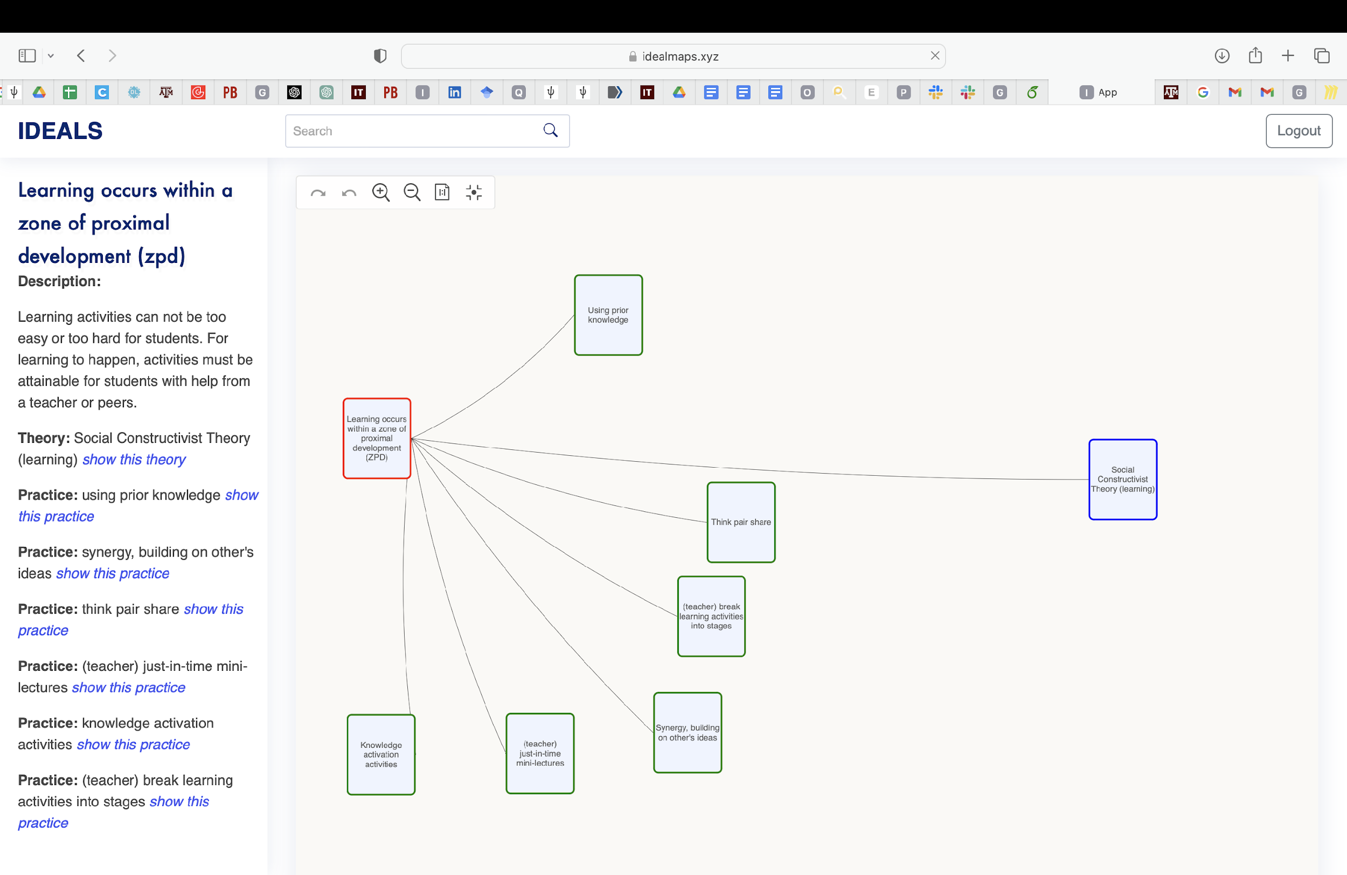
Assumptions

Slide 13
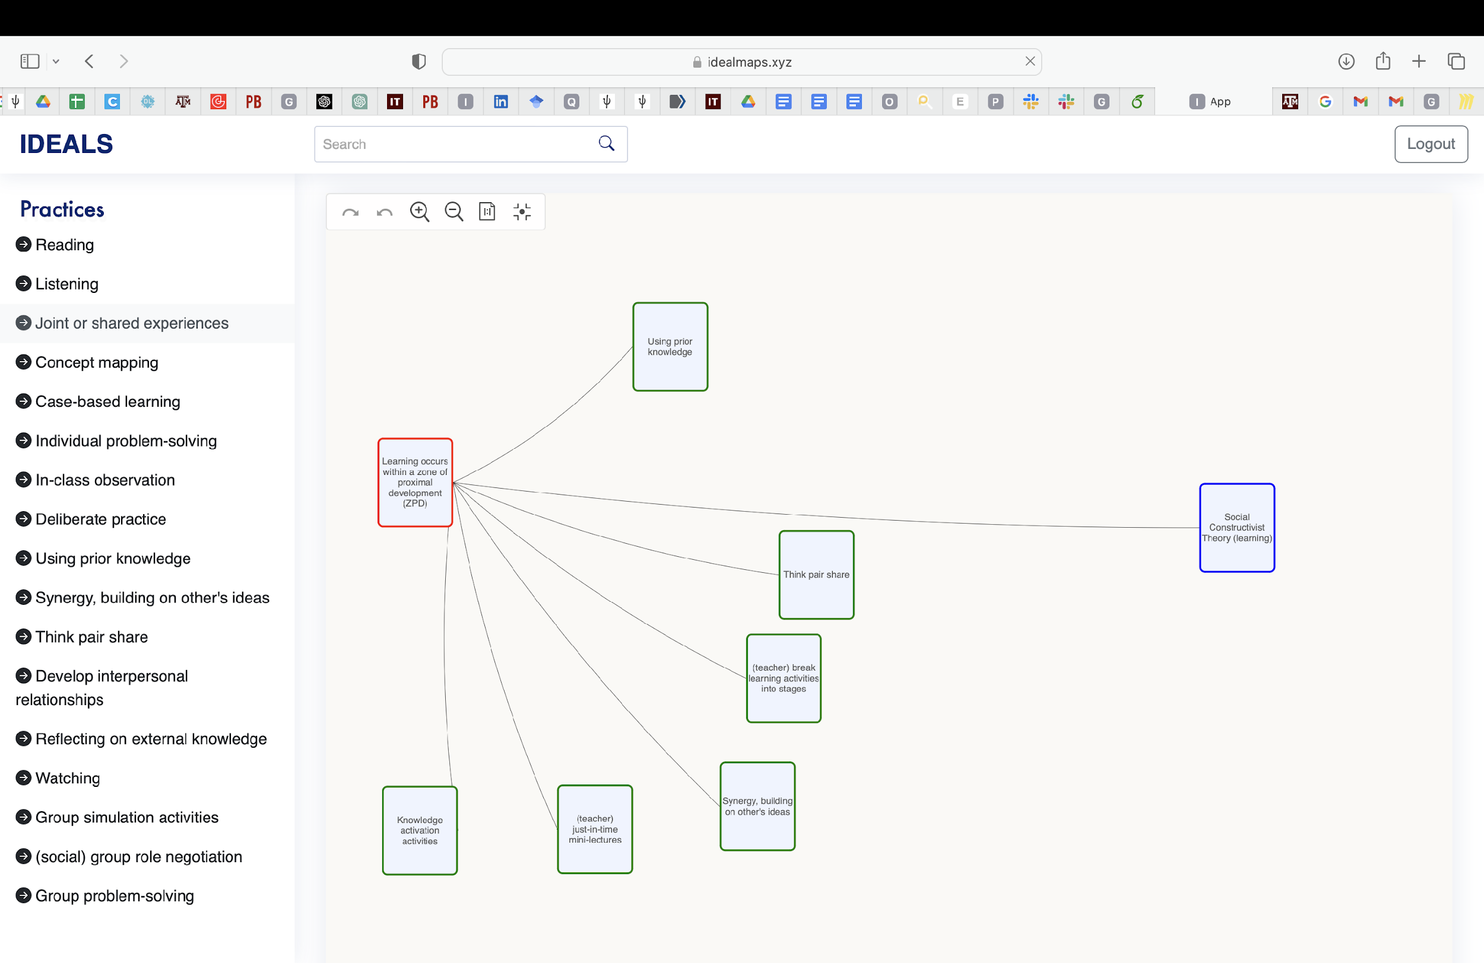
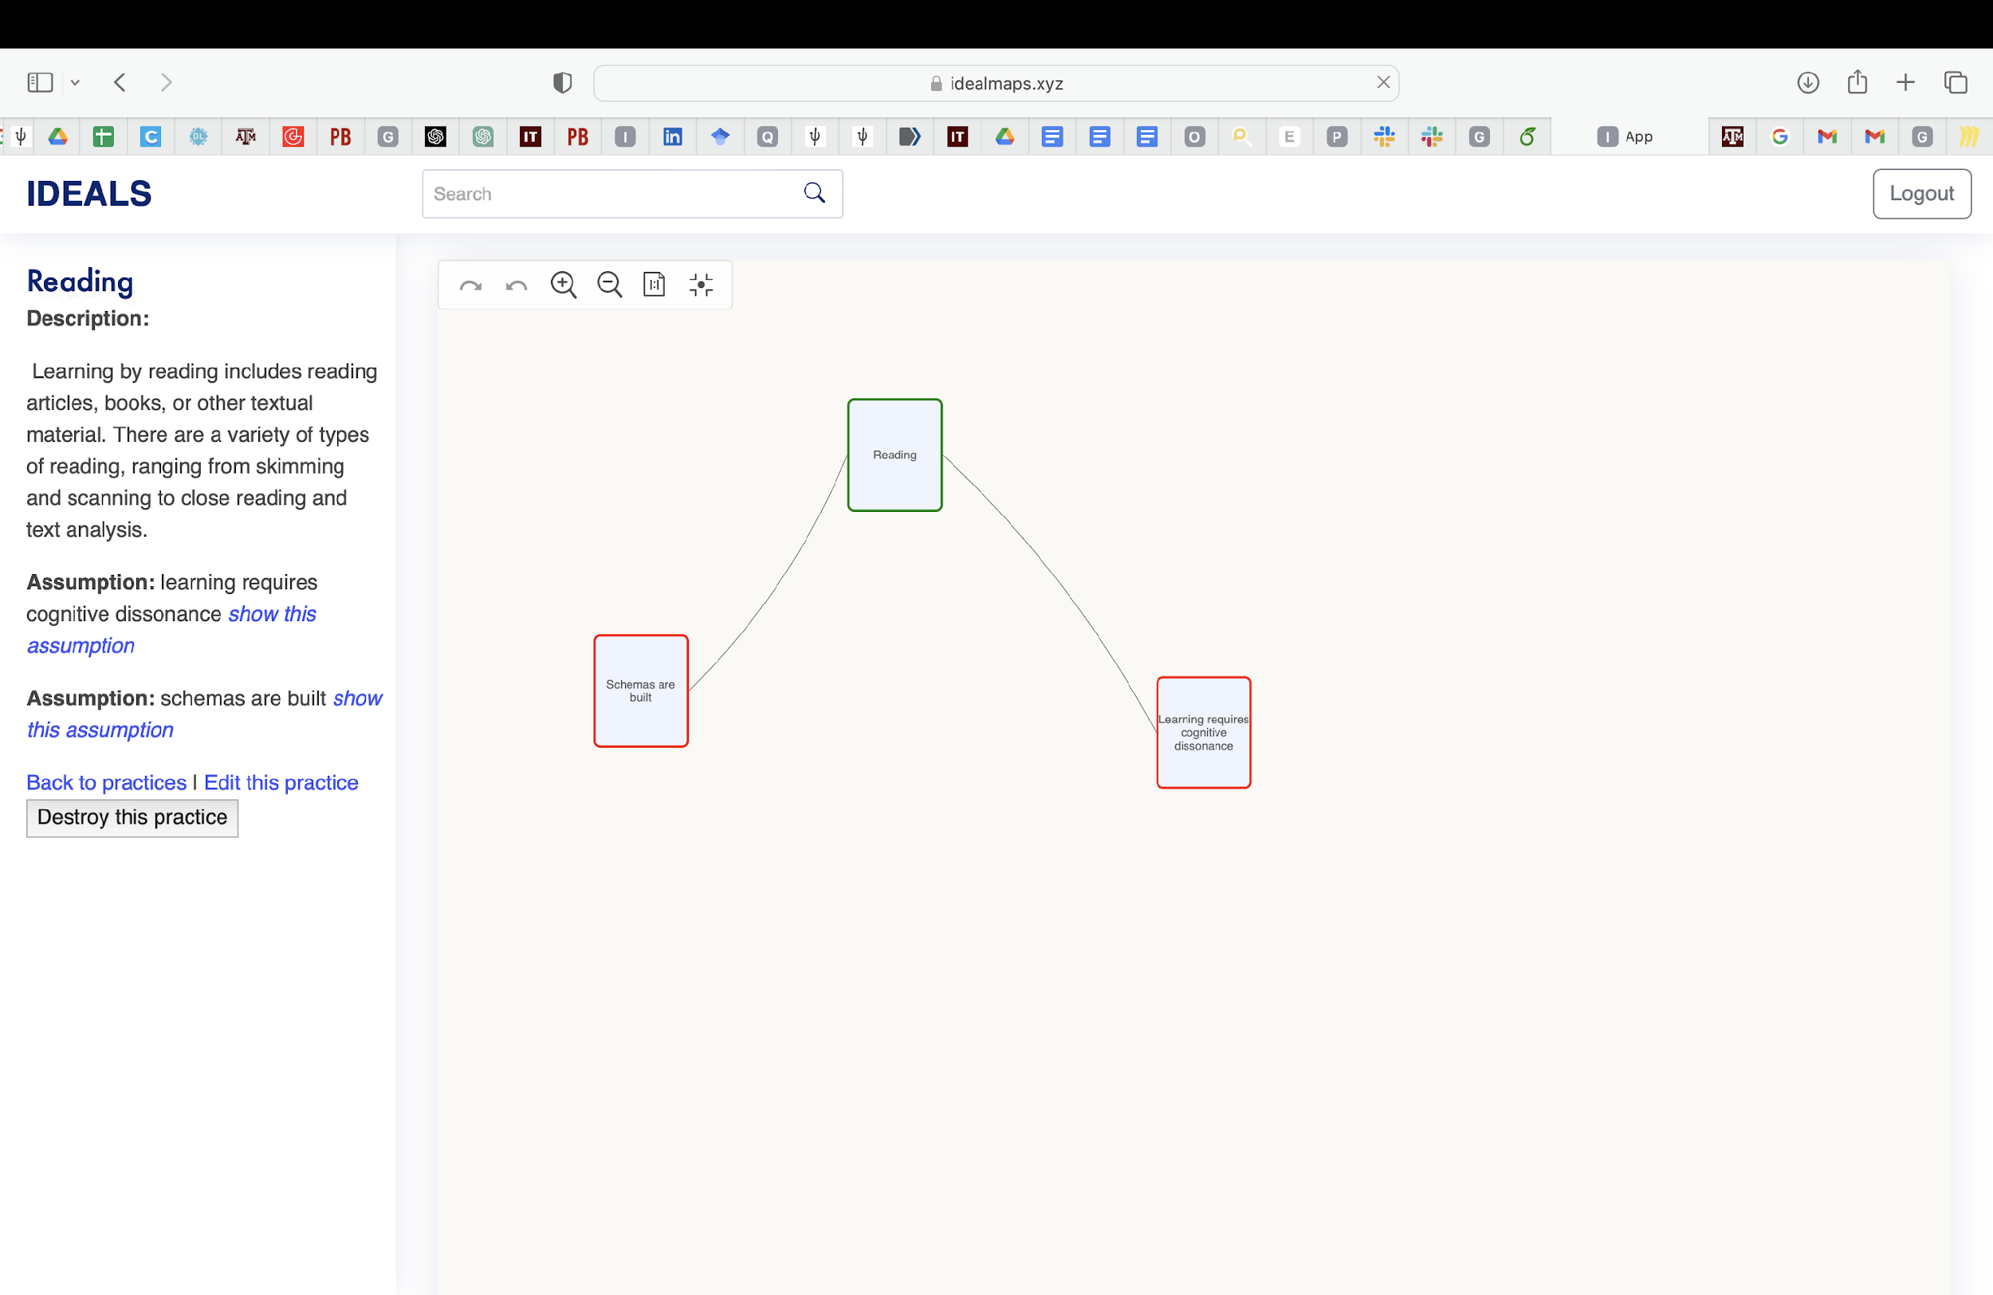
Practices

Slide 14
Conclusion
We successfully accomplished all functional requirements stipulated by the client.
Our adaptable and agile methodology allowed us to incorporate and execute additional features that arose mid-project per the client’s request.
It can be concluded that the project has been successfully completed, meeting and exceeding client expectations.
Our efforts were corroborated by the client’s affirmation of the project’s successful outcome.

Slide 15
Thank You!

